Slide 1
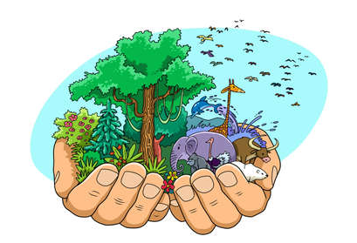
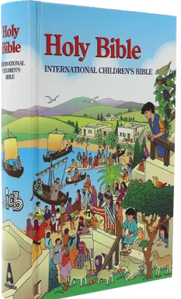
Year 2 Who made the world?
Prior Learning
Christians believe that God created the universe and that humans should
care for the world because it belongs to God.
Vocabulary
Genesis | The first book in the Christian Bible
Old Testament | The first section of the Bible.
creation | The act of bringing the world into ordered existence
Big Story | The story of the Bible-God ‘s rescue plan for the world
Key Content
The creation story for Christians and Jews is found in the book of Genesis in the Bible.
Retell the story of creation - sequence the story.
The creation story is the beginning of the ‘big story’ of the Bible.
Christians show they are thankful by giving to others.
We have a special responsibility to look after God’s world

