Slide 1
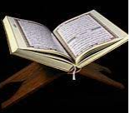
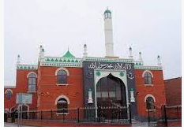
Year 2 Who is a Muslim and what do they believe?
Prior Learning
People who are Muslim belong to the Islam faith.
Vocabulary
Allah | Muslim word for God
Muhammad | Religious leader for Muslim people
Mosque | Muslim place of worship
Quran | Muslim holy book
Key Content
The Muslim word for God in the Arabic language is Allah.
The prophet Muhammad taught Muslim people how to follow God.
The stories Muhammad told are important to Muslims and show them how they should live their lives.
A Mosque is a holy building for Muslims. It helps Muslims pray and worship Allah .
The Quran is the Holy book for Muslims. It is written in Arabic. It is kept on a stand and covered over as a sign of respect.

