Slide 1
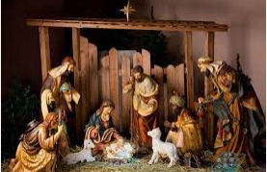
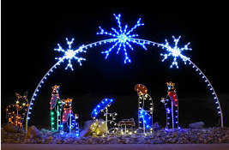
Year 2 Why does Christmas matter to Christians?
Prior Learning
Vocabulary
Mary and Joseph | Jesus’ mum and dad
Bethlehem | The town Jesus was born in
Incarnation | This means God on Earth
Gospels | The first four books of the New Testament : Matthew, Mark, Luke and John. They tell the story of Jesus’ life.
Nativity | The birth of Jesus Christ
Christians believe that Jesus is God and that he was born as a baby in Bethlehem. •
The Bible points out that his birth showed that he was extraordinary and that he came to bring good news
Christians celebrate Jesus’ birth; Advent for Christians is a time of getting ready for Jesus’ coming
Key Content
The story of Christmas begins with the birth of Jesus in a stable in Bethlehem, to Mary and Joseph. Christians believe that Jesus is the son of God – this is called Incarnation.
Shepherds and Wise men came to visit Jesus after he was born.
The stories of Jesus’ life are in the Bible, in the books called the Gospels.
The story of Jesus’ birth is called the Nativity.
Christians celebrate Christmas by giving gifts and remembering what they are thankful for and to be kind and generous
Jesus’ birth is part of the ‘Big Story’ of the Bible.

