Slide 1
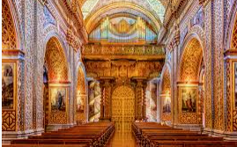
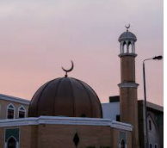
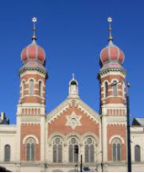
Year 1 What makes some places sacred?
Prior Learning
I know a Church is where Christians go to worship.
I know a Mosque is where Muslims go to worship
Vocabulary
Artefacts | Special objects and symbols found in places of worship.
Lectern | Where the Bible is placed in a Church
Synagogue | A Jewish place of worship
Wudu | The act of washing before Muslims worship
Minaret | A place in the Mosque where the call to prayer is made.
We all have special places where we like to visit.
Christian churches are not all the same- they look different on the outside and on the inside. They have many artefacts which help the believers to worship, including a cross, candles and a lectern.
Jewish believers worship in a synagogue. Men wear a prayer shawl (tallit) and a skullcap( kippah) when worshipping.
When Muslims enter the Mosque they take their shoes off and women cover their heads to show respect.
Muslims use a prayer mat and prayer beads to help them worship.
Places of worship can be similar and different to each other.

