Slide 1
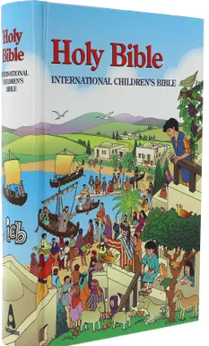
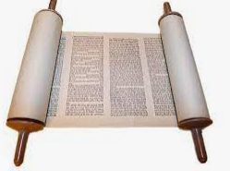
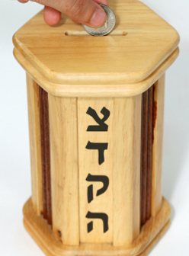
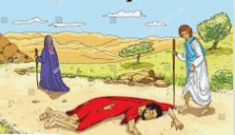
Year 1 How should we care for others and the world, and why does it matter?
Prior Learning
Vocabulary
Tzedekah | Jewish idea of charitable giving to those who need help
Genesis | The first book of the Bible
Torah | The Jewish sacred book
The Good Samaritan | A story which Christians believe tells Christians how to be a good neighbour
Christian people follow the religion of Christianity.
Jewish people follow the religion of Judaism.
Christians’ sacred book is called The Bible.
Key Content
Everyone is valuable and unique.
The Golden Rule for everyone is to ‘treat others how we would like to be treated’
The story of the Good Samaritan tells us how to be a good neighbour to everyone.
At the Jewish festival of Sukkot people spend time living outside to remember the Israelites escape from Egypt.
Tzedekah is the Jewish idea of charitable giving to
those who need help. For Jewish people this is to help to make the world a better place.
Jews and Christians share the stories of Genesis.

