Slide 1
Issue 3 October 2022
William Gilbert Endowed C of E Primary School and Nursery
www.williamgilbertend.derbyshire.sch.uk Safeguarding and Child Protection
at William Gilbert School
Welcome to our Safeguarding Newsletter
Coming up in this issue – Anti – Bullying, Fire Safety, Online Safety – Tik Tok & You Tube -Do you know what your child is watching? Road Safety, Anxiety -Mental Health and playing out after school.
Safeguarding & Child Protection is the most important issue for our children and young people. At William Gilbert School, we feel it is crucial to work with our parents and the high-quality agencies that support schools and young people, so that we can offer a safe environment allowing children to be aware of the risks they may face and how to respond to them safely.
Some parents and carers may find some of the content of this letter disturbing or deem it to be inappropriate for primary schools. The well being and safety of our children is at the very centre of school life, but we do need to be aware that these issues can and do exist. Please be reassured that the issues covered here are dealt with in school in a sensitive and entirely age appropriate way. We have a moral and legal duty to raise awareness and provide this information.
The Safeguarding Team at William Gilbert Primary?
The Designated Safeguarding Lead has a vital role in taking lead responsibility for child protection issues in school. We would like to introduce Mrs Aston as a newly qualified DSL to our team. Mrs Whyld continues to be the most senior in position. A DSL is always available during school hours for staff to discuss any safeguarding concerns. All our DSLs are trained to take on this role; the training is updated every two years enhanced by mid-term courses and conferences. The DSL has many responsibilities. They give advice, manage referrals, provide training and investigate any concerns.
A Safeguarding Curriculum
‘Keeping Children Safe in Education 2022’(KCSIE) reminds us that safeguarding and promoting the welfare of children is everyone’s responsibility. Everyone who comes into contact with children and their families has a role to play. This means that they should always consider what is in the best interests of the child. At WGES we believe that it is vital for our children to have opportunities to learn how to stay safe both in and outside of school—learning which comes from parents and staff at WGES.
Useful Acronyms & Vocabulary
DSL: Designated Safeguarding Lead
PREVENT: Part of the Governments Counter Terrorism Strategy to stop people being drawn into extremism
LADO: Local Authority Designated Officer - who deals with position of trust safeguarding issues
CEOP: Child Exploitation and Online Protection Centre
National Online Safety -Online training and support for families about all things online
KCSIE: Keeping Children Safe in Education (available on the school web pages)
Who’s Who at WGES
Mrs S J Whyld - Senior DSL
Mrs E H Britten - Deputy DSL
Mrs A Aston – DSL and Well-being and Pastoral mentor (Early Help)
Dr N Ruggins – Safeguarding Governor
Miss K Whiting – Acting EYFS/KS1 SENCO and Mental Health First Aider
Miss B Rice – Acting KS2 SENCO
Mrs S Owen – Mental Health first aider
Designated Safeguarding Leads can be accessed via our safeguarding email
safeguarding@williamgilbertend.derbyshire.sch.uk
If you believe that a child or an adult is at immediate risk of harm and in need of protection then you should call the Police - 999, straight away.
Alternatively if you want advice from the Police and the child or adult is not in immediate need of protection, you can call the Police on the telephone number 101.
Here are some examples coming this term that you can discuss with your child
Weekly Safeguarding Awareness Assemblies covering the following topics this term –Fire Safety, Road Safety Week (14th – 20th November) Anti-Bullying Week (14th – 18th November) Children in Need (19th November) Anxiety – Mental Health, Cyberbullying, Cybercrime and water safety – frozen ponds/canals
Religious Education lessons reinforce messages of tolerance and respect for others. Opportunities to learn about other faiths and visit places of worship.
RSHE lessons – see knowledge mats on the school website for year group information
Links with the NSPCC initiatives through class assemblies and workshops this term with follow up lessons.
Engagement with charities that broaden pupils awareness, understanding and worldview
Behaviour policy and practice in school under the ‘Golden Rules’
Year 6 will be visiting the houses of parliament in London – work on the British Value of Democracy and Rule of Law will be covered including equality.

Slide 2
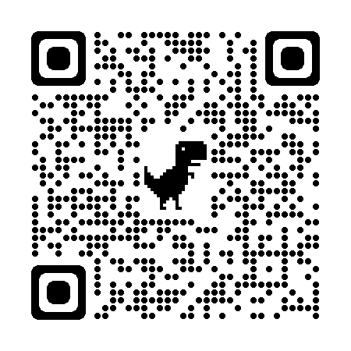
Keeping safe online
Safeguarding in the Community Updates
We recently had a visit from our Police Community Support Officer who delivered a presentation to the children about online safety and antibullying. As part of his workshops, the children were asked what sorts of online activity they access at home. Their answers were then shared with our safeguarding team in the context of behaviours being seen across the county and beyond, and we feel it is important that parents and carers are made aware. One area we would like to explore in this section of the newsletter is the use of social media platforms including Tik Tok and You Tube.
Tik Tok – The Facts
TikTok is a free social media platform that lets you create, share and watch short clips. The app is popular for viral dances and celebrity cameos and is a creative and fun platform aimed at teens.
13 is the minimum age according to TikTok’s terms and conditions.
Parents have expressed concerns about the inappropriate language of some of the videos posted which may make this less suitable for younger children.
Children in our school talk about Tik Tok, they have been observed recreating harmless Tik Tok dances on the playground.
What should parents be concerned about?
When you download the app, users can see all the content without creating an account although they are not able to post, like or share anything until they’ve set up an account on the app.
By default, all accounts are public so anyone on the app can see what your child shares. However, only approved followers can send them messages.
Users can like or react to a video, follow an account or send messages to each other, so there is the risk that strangers will be able to directly contact children on the app.
Children may be tempted to take risks to get more of a following or likes on a video so it’s important to talk about what they share and with who.
TikTok trends and challenges are a popular part of the social media platform and change often. Users can re-create content from dance challenges to memes about current events. While many are harmless and fun, there are others that need to be monitored closely.
These challenges and trends can harm a child’s physical health and mental wellbeing:
The silhouette challenge: users create images or videos that are edited using a filter so they appear as a silhouette. Many are sexualizing themselves with this challenge. Filters can also be removed by others, so users must be careful about what they are wearing behind the camera.
The blackout challenge: around before TikTok existed, it involves users interrupting their oxygen intake until they get close to losing consciousness. This challenge has lead to the recent deaths of multiple children aged 9-12.
Back cracking challenge: a user cracks the back of their friend without any training. Medical professionals warn that this can twist and pull on the spine, resulting in long-term damage.
Nutmeg challenge: consuming large amounts of nutmeg has been shown to affect the nervous system, potentially causing hallucinations. However, research shows it can also cause dizziness, nausea, drowsiness, dry mouth, confusion, and seizures.
Full face wax trend: presented as a skincare routine, users cover their entire face with wax. There is risk of suffocation if the wax enters the airways. Because wax is designed to harden, once in the airways, it can only be removed surgically.
The magnet challenge: using small magnetic balls, users pretend to have piercings on their ears, noses, and lips. More extreme versions see users swallowing these magnetic balls so that they can stick magnets on their skin and be ‘magnetic’ themselves. This has resulted in serious hospitalisation and surgery to remove these harmful magnets.
These challenges change often – we have become aware recently of a challenge involving aerosols which secondary school children are taking part in – The deodorant test of endurance involves spraying for as long as possible onto a person's bare skin, with the cold apparently leaving apparently “light” burn marks. The damage does not come from the deodorant itself, but the aerosol spray, which cools quickly on the skin and effectively produces frostbite.
Your child may not have a Tik Tok account but may be viewing content via your device and app. It is therefore important that you are aware of what your child is accessing and supervise their viewing.
Useful Acronyms & Vocabulary
My Concern – Safeguarding record system (safeguarding and child protection software for schools used at WGES).
Cyberbullying is any form of bullying which takes place online or through smartphones and tablets – adults and children can be victims.
CEOP: Child Exploitation and On-line Protection Centre
PCSO: Police Community Support Officers
https://www.thinkuknow.co.uk/parents/
Online Safety
Information at WGES
We have a wealth of information on our school website for parents to access.
Please visit https://www.williamgilbertend.derbyshire.sch.uk/staying-safe-on-the-internet/
Or scan the QR code below
-
Support for Parents
For more information and advice
visit Internet Matters to find a useful guide for parents
https://www.internetmatters.org/resources/tiktok-safety-guide-for-parents-to-support-young-people-on-the-app/

Slide 3
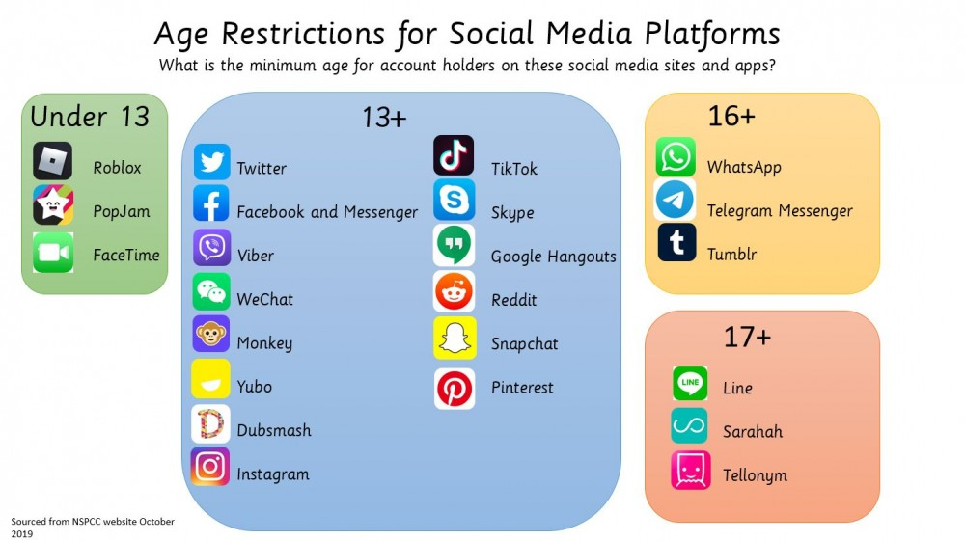
Keeping safe online
Useful Acronyms & Vocabulary
My Concern – Safeguarding record system (safeguarding and child protection software for schools used at WGES).
CEOP: Child Exploitation and On-line Protection Centre
Find further support about being smart online at:
https://www.childnet.com/parents-and-carers/
Online Safety
Information at WGES
We have a wealth of information on our school website for parents to access.
Please visit https://www.williamgilbertend.derbyshire.sch.uk/staying-safe-on-the-internet/
Or scan the QR code below
-
Watching videos - YouTube
Entertainment for families no longer means sitting in front of the television, watching appropriate programming at set times in the day. Now, there are multiple ways to watch your favourite shows, including online. And one of the most popular ways is through YouTube.
When used safely and responsibly, YouTube provides a wealth of opportunities for children to learn, be entertained, be creative, and play. However, with so much content available – much of which you don’t want your younger children to see.
Some of the shows our oldest children said they watched at home were a cause for concern and further support.
For primary aged children we would recommend using YouTube Kids – this is a separate app made for children under 13 which allows a safer and simpler experience for them to explore. The app also has a parent-supervised experience to help guide your kids on their journey. Check out the YouTube Kids app parental control guide for more information.
Here Internet Matters’ YouTubing tips
Have regular conversations with your children about their on and offline activities and know where and how they can get help if they should see anything that upsets them.
Does your child have a YouTube channel? If yes, do you watched their videos? Do you know what they are posting?
Watch and enjoy YouTube shows together with your child to help them make sense of themes they don’t understand and gauge what content will be beneficial for their overall wellbeing.
Use Supervised Experiences if your child is using the main YouTube platform.
Try the YouTube Kids app if you have children under 13.
Google Family Link is great to use for other parental controls.
Use Google SafeSearch which filters inappropriate search results.
Report any harmful content.
For more information follow the link below
https://www.internetmatters.org/hub/guidance/youtube-tips-and-tricks-to-keep-your-children-entertained-and-safe/
Supervise their online activity: Keep the devices your child uses in communal areas of the house such as the living room or kitchen, where an adult is able to supervise. Primary-age children should not access the internet in private spaces alone, such as in a bedroom or bathroom.
Make sure they know where to go for support: Remind your child they can always speak to you or an adult they trust if anything happens online that makes them feel worried or upset.
Visit Google’s Interland to play fun games as a family to be internet awesome
https://beinternetawesome.withgoogle.com/en_us/interland

Slide 4
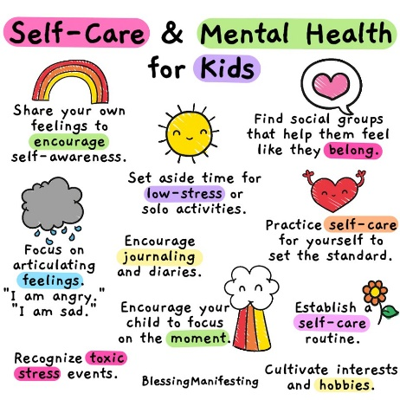
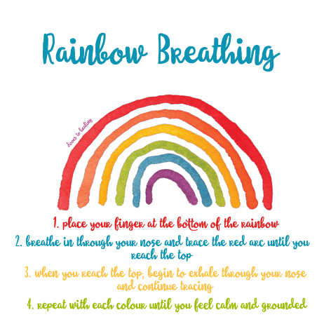
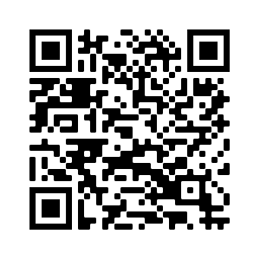
Mental Health
At William Gilbert C of E Primary School and Nursery, we are committed to supporting the emotional health and wellbeing of our pupils and staff. We know that everyone experiences life challenges that can make us vulnerable, and, at times, anyone may need additional emotional support. We take the view that positive mental health is everybody’s business and that we all have a role to play. Our Relationships and Health Education lessons support pupils in developing strategies to take care of their mental health and well being. Last month we raised awareness further through assemblies to mark World Mental Health Day.
Useful Acronyms & Vocabulary
CAMHS: Child and Adolescent Mental Health Services
My Concern – Safeguarding record system (safeguarding and child protection software for schools used at WGES).
EHA: Early Help Assessment
SEND: Special Educational Needs & Disabilities
Safeguarding Information at WGES
We have a wealth of information on our school website for parents to access, including important documents and contact details.
Please visit www.williamgilbertend.derbyshire.sch.uk
Scan the QR code below to take you to our parenting support page for further advice on mental health
The children’s mental health charity, Place2Be, has launched a new website aimed at helping parents with typical situations they may experience with children.
The Parenting Smart website can be found here: https://parentingsmart.place2be.org.uk/
At William Gilbert Primary School and Nursery we:
help children to understand their emotions and feelings better
help children feel comfortable sharing any concerns or worries
help children socially to form and maintain relationships
promote self-esteem and ensure children know that they are valued
Our nurture sessions provide targeted support for children who need help with challenges they are dealing with. As class teachers we encourage self-soothing strategies such as simple breathing techniques. One example you could try at home is ‘Rainbow Breathing’
If you are concerned about your child’s mental health and wellbeing please get in touch. We can offer advice and support. Mrs Aston is our Pastoral and Wellbeing lead and can be approached at the school gate or via the school email address enquiries@williamgilbertend.derbyshire.sch.uk Below you can find links to other areas of further reading and support.
A guided Rainbow Breathing activity available here
https://www.youtube.com/watch?v=ik9opIy-IbI
As a parent or carer, you may sometimes experience your own mental health issues or anxieties and find it difficult to cope with parenting your child. But with the right support and resources it is perfectly possible to be a good parent while managing these problems and to care for and support your children in a positive way. For those affected, the websites below may be helpful, or accessing early help through our well-being and pastoral mentor – Mrs Aston (01332) 840 395 or enquiries@williamgilbertend.derbyshire.sch.uk
For further advice on any of these challenges the Mind website has lots of advice and support
https://www.mind.org.uk/information for parents mental health
The Mental Health Foundation have provided a useful leaflet containing their best mental health tips - backed by research
Each of our tips has been created to help us look after our mental health, and, importantly, each is backed up by evidence from research. Find it here Looking after your Mental Health - Top Tips
Parental Support
We know parenting isn’t always easy. Young Minds have lots of practical advice and tips on supporting your child - from how to encourage your child to open up about their feelings to dealing with mental health services. No matter what you and your child are going through, things can get better. They also have a Parents Helpline which can provide advice and support if you're worried about a child or young person.
Visit https://www.youngminds.org.uk/parent/

Slide 5
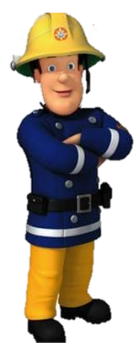
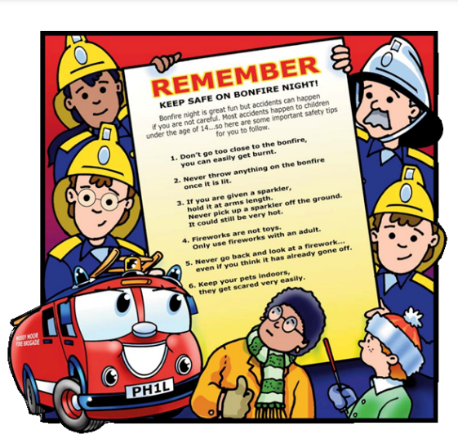
Keeping Safe in the Community
Useful Acronyms & Vocabulary
RoSPA: Royal Society for the Prevention of Accidents
My Concern – Safeguarding record system (safeguarding and child protection software for schools used at WGES).
EHA: Early Help Assessment
SEND: Special Educational Needs & Disabilities
Safeguarding Information at WGES
We have a wealth of information on our school website for parents to access, including important documents and contact details.
Please visit www.williamgilbertend.derbyshire.sch.uk
If you believe that any child is in danger ring Call Derbyshire Tel: 01629 533190 choosing the option for urgent child protection calls at any time
Road Safety
All class teachers encouraged pupils to take part in the Derbyshire County Council Travel Smart Week 17th – 21st October 2022. These regular events encourage children to make more active and environmentally friendly journeys to school.
In class we record how many children have walked, cycled, scooted, travelled by bus, park and stride, car share or by car.
Coming soon…scooter and bike storage racks to the infant and junior entrances to encourage more children to be active on their journeys to school.
The roads close to school become particularly busy and congested at the start and end of the school day. We would encourage all parents/carers to walk to school if possible. If not we would urge you to park away from Vicarage Lane, Castle Hill and other immediate streets and walk to school.
We teach children about Road Safety in our weekly safeguarding assemblies. This will be a focus during Road Safety week 14th – 20th November 2022.
Further support
To reinforce these skills on the journey to school visit these useful sites to watch a Road Safety video.
THINK! campaign is run by the Department for Transport and has a wealth of resources.
Think Road Safety video age 3-6
https://www.think.gov.uk/resource/safer-journeys-anthem/
Think Road Safety videos age 7-12
https://www.think.gov.uk/education-resources/explore-education-resources/?age%5B0%5D=7-to-12&resource_type%5B%5D=film
Fire Safety
Staying safe with fireworks.
Fireworks can create a spectacularly colourful evening, but if safety advice is not followed, fun celebrations can soon turn to disaster.
Whilst Derbyshire Fire & Rescue Service recommends that people should consider attending an organised bonfire event, many people still choose to hold their own private bonfire party at home. A few simple precautionary safety measures can help ensure that everyone stays safe and can enjoy the celebrations without injury or harm.
If you are having a firework party at home, you can make the occasion fun and safe for everyone by following the Firework Code.
Come and watch some short videos helping you learn about how to keep safe on Bonfire Night
https://www.cheshirefire.gov.uk/young-people/fireman-sam

Slide 6
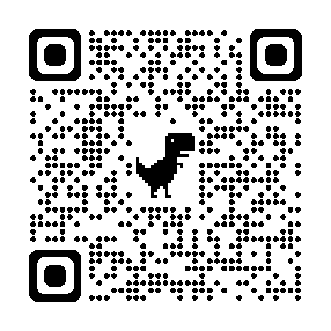
Anti-Bullying
Anti-Bullying Week 2022 is coordinated in England and Wales by the Anti-Bullying Alliance. It will take place from 14th to 18th November 2022 and has the theme Reach Out. The week will kick off with Odd Socks Day on Monday 14th November, where adults and children wear odd socks to celebrate what makes us all unique. All week we will use Anti-bullying week to continue our work in raising pupils awareness of what bullying is, what it is not, how to respond and reach out for help with trusted adults at school and home. This work will be through workshops and assemblies.
Bullying is behaviour by an individual or group, repeated over time,
which intentionally hurts other people, either physically or emotionally
We support the Anti-Bullying Alliance call to action:
Bullying affects millions of lives and can leave us feeling hopeless. But it doesn’t have to be this way. If we challenge it, we can change it. And it starts by reaching out.
Whether it’s in school, at home, in the community or online, let’s reach out and show each other the support we need. Reach out to someone you trust if you need to talk. Reach out to someone you know is being bullied. Reach out and consider a new approach.
And it doesn’t stop with young people. From teachers to parents and influencers to politicians, we all have a responsibility to help each other reach out. Together, let’s be the change we want to see. Reflect on our own behaviour, set positive examples and create kinder communities.
It takes courage, but it can change lives. So, this Anti-Bullying Week, let’s come together and reach out to stop bullying.
Useful Acronyms & Vocabulary
Bystander: A bystander is ‘a person who does not become actively involved in a situation where someone else requires help’ (Clarkson 1996, p6) and in this way is understood to be a passive observer, an onlooker who watches something happening, but stays on the side-lines and doesn’t intervene or get help, even if someone needs it.
Cyberbullying: Cyberbullying includes sending, posting, or sharing negative, harmful, false, or mean content about someone else. It can include sharing personal or private information about someone else causing embarrassment or humiliation. Some cyberbullying crosses the line into unlawful or criminal behaviour.
Safeguarding Information at WGES
We have a wealth of information on our school website for parents to access, including important documents and contact details.
Please visit www.williamgilbertend.derbyshire.sch.uk
Scan the QR code below to take you to our Parent Support page
Here you will find a wealth of information and resources to help you understand issues around bullying, how we support children in school and leaflets for parents to help you have discussions around conflict and bullying.
What is Odd Socks day?
Most importantly, Odd Socks Day is designed to be fun! It’s an opportunity to encourage people to express themselves and celebrate their individuality and what makes us all unique!
There is no pressure to wear the latest fashion or to buy expensive costumes. All you have to do to take part is wear odd socks to school, it couldn’t be simpler! We are asking participants to make a £1 donation - or any donation you think appropriate – which we will send to the Anti-Bullying Alliance to support their continuing work.
All adults at school take reports of bullying seriously and will act upon it.
Pupils are encouraged to tell a trusted adult or a trusted friend who will inform a school adult. We expect bystanders (children, school staff and parents/ carers) to tell an adult in school. Bystander behaviour is regularly a feature of our safeguarding assemblies and RHE lessons.

Slide 7
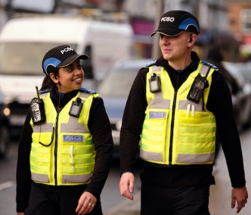
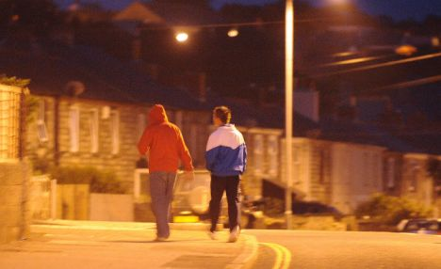
Lengthen night and shorten day…
Useful Acronyms & Vocabulary
CAMHS: Child and Adolescent Mental Health Services
My Concern – Safeguarding record system (safeguarding and child protection software for schools used at WGES).
PCSO: Police Community Support Officer
EHA: Early Help Assessment
Safeguarding Information at WGES
We have a wealth of information on our school website for parents to access, including important documents and contact details.
Please visit www.williamgilbertend.derbyshire.sch.uk
If you believe that any child is in danger ring Call Derbyshire Tel: 01629 533190 choosing the option for urgent child protection calls at any time
Fall, leaves, fall
By Emily Bronte
Fall, leaves, fall; die, flowers, away;
Lengthen night and shorten day;
Every leaf speaks bliss to me
Fluttering from the autumn tree.
I shall smile when wreaths of snow
Blossom where the rose should grow;
I shall sing when night’s decay
Ushers in a drearier day.
Clocks going back
Every autumn when the clocks go back and sunset suddenly occurs earlier in the day, there are a host of negative impacts on the way we live our lives.
The number of road casualties rises, with the effects being worse for the most vulnerable road users like children.
It means that we have less usable daylight in the evenings to do the things we enjoy in the outdoors or in social environments. For our oldest pupils who may be playing out close to home or at the park and we remind parents to be extra vigilant in the supervision of your children. It is not appropriate for primary aged pupils to be playing out in the dark. Use the event of the clocks going back to discuss road safety with your child and reduce your child’s curfew so they arrive home in the light.
Community Concerns
Before half term the local PCSO visited school and delivered an anti-social behaviour workshop to our oldest pupils. Within this workshop he introduced them to the fact that at 10 years old they are responsible for their words and actions.
He shared with staff, a warning about a social media trend that is causing distress to local residents. There have been reports of cherry-knocking teenagers kicking doors, ringing door bells and running off.
The act of knocking on a door and running is known by different things in different regions of the country. You may know it as ‘knock and run’ ‘knock, knock ginger’, ‘chickenelly’, ‘ding-dong ditch’, ‘nicky-nicky-nine-doors’ Whatever you know it by, it was made illegal in the United Kingdom in 1839 and was introduced by the Metropolitan Police Act and is still in place today, meaning that all its laws can still be enforced.
Local police are urging parents to talk to their children about the trend, which is popular on TikTok and sees people filming themselves as they knock on doors, kick doors, or throw eggs, and then run away. "Whilst it may appear humorous, it has caused a great deal of distress to some of the local residents.” This prank has particularly upset some of the vulnerable members of our community.
This activity can lead to serious repercussions for both the people knocking and the residents affected. We appeal to parents/carers of children/teenagers to speak to any children you know about this trend as it may stop them taking part and causing damage to residents property in the community.
If you are a victim of this anti social behaviour police advise you not to take this matter into your own hands but to report it by calling 101.
To keep yourself and your home safe, here’s what we suggest you do when a stranger comes knocking:
Perform a lock check
See who it is (through peephole or camera)
Speak with the person through the door
Call the police (if needed)
Safeguarding children is everyone’s responsibility
Keep the lines of communication open with your child. Conversations with your child that are appropriate to their age are key to safeguarding them. Be aware that the age of criminal responsibility in England and Wales is 10 years old. If you are concerned that your child may be involved in anti-social behaviour please get in touch with us at school so we can support you and your child.

